Slide 1

CPAIOR 2024 | Session 12: Decision-focused Learning
CaVE
A Cone-Aligned Approach for Fast Predict-then-Optimize
Presented by Bo Tang
Uppsala, May 30, 2024

Slide 2

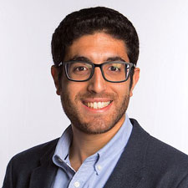
CaVE: A Cone-Aligned Approach for Fast Predict-then-Optimize
CPAIOR 2024 | University of Toronto
Authors
Elias B. Khalil
Assistant Professor
Department of Mechanical & Industrial Engineering, University of Toronto
SCALE AI Research Chair
Data-Driven Algorithms for Modern Supply Chains
Bo Tang
PhD Candidate
Department of Mechanical & Industrial Engineering, University of Toronto

Slide 3
CaVE: A Cone-Aligned Approach for Fast Predict-then-Optimize
CPAIOR 2024 | University of Toronto
Introduction
CaVE (Cone-aligned Vector Estimation) is a Decision-focused Learning / End-to-end Predict-then-optimize approach for Binary Linear Programs (BLPs).
End-to-End:
The loss function of CaVE focuses on decision quality.
Efficiency:
The algorithm of CaVE utilizes non-negative least squares (NNLSs) instead of solving BLPs.

Slide 4

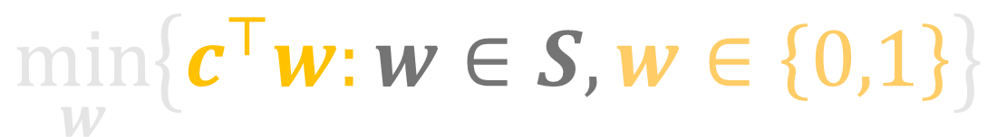



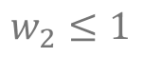

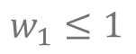

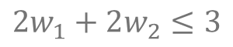
CaVE: A Cone-Aligned Approach for Fast Predict-then-Optimize
CPAIOR 2024 | University of Toronto
Notation
$$w_{2}$$
Linear Objective
Function
$$w_{1}≤1$$
Binary Domain
$$1$$
$$w_{2}≤1$$
$$\min_{w}\left\{c^{⊤}w:w∈S,w∈\left\{0,1\right\}\right\}$$
$$c$$
$$2w_{1}+2w_{2}≤3$$
Feasible
Region
$$w_{1}$$
Decision Variables
$$0$$
$$1$$

Slide 5




CaVE: A Cone-Aligned Approach for Fast Predict-then-Optimize
CPAIOR 2024 | University of Toronto
Predict, then Optimize
$$\min_{w}\left\{ {c_{1}}^{⊤}w:w∈S \right\}$$
$$\min_{w}\left\{ {c_{2}}^{⊤}w:w∈S \right\}$$
$$\min_{w}\left\{ {c_{3}}^{⊤}w:w∈S \right\}$$
$$⋱$$

Slide 6



CaVE: A Cone-Aligned Approach for Fast Predict-then-Optimize
CPAIOR 2024 | University of Toronto
Predict, then Optimize
Unknown Coefficients
$$\min_{w}\left\{ {c_{1}}^{⊤}w:w∈S \right\}$$
$$\min_{w}\left\{ {c_{2}}^{⊤}w:w∈S \right\}$$
$$\min_{w}\left\{ {c_{3}}^{⊤}w:w∈S \right\}$$
Identical Constraints
$$⋱$$

Slide 7




CaVE: A Cone-Aligned Approach for Fast Predict-then-Optimize
CPAIOR 2024 | University of Toronto
Predict, then Optimize
Unknown Coefficients
Observed Feature Vectors
$$\min_{w}\left\{ {c_{1}}^{⊤}w:w∈S \right\}$$
$$x_{1}$$
$$\min_{w}\left\{ {c_{2}}^{⊤}w:w∈S \right\}$$
$$x_{2}$$
$$\min_{w}\left\{ {c_{3}}^{⊤}w:w∈S \right\}$$
$$x_{3}$$
Identical Constraints
$$⋱$$
$$⋮$$

Slide 8

CaVE: A Cone-Aligned Approach for Fast Predict-then-Optimize
CPAIOR 2024 | University of Toronto
Predict, then Optimize
Unknown Coefficients
Observed Feature Vectors
$$\min_{w}\left\{ {c_{1}}^{⊤}w:w∈S \right\}$$
$$x_{1}$$
$$\hat{c}=g\left(x;θ\right)$$
$$\min_{w}\left\{ {c_{2}}^{⊤}w:w∈S \right\}$$
$$x_{2}$$
Prediction
$$\min_{w}\left\{ {c_{3}}^{⊤}w:w∈S \right\}$$
$$x_{3}$$
Identical Constraints
$$⋱$$
$$⋮$$

Slide 9
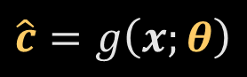
CaVE: A Cone-Aligned Approach for Fast Predict-then-Optimize
CPAIOR 2024 | University of Toronto
Predict, then Optimize
Unknown Coefficients
Observed Feature Vectors
Model Parameters
$$\min_{w}\left\{ {c_{1}}^{⊤}w:w∈S \right\}$$
Predicted
Coefficients
$$x_{1}$$
$$\hat{c}=g\left(x;θ\right)$$
$$\min_{w}\left\{ {c_{2}}^{⊤}w:w∈S \right\}$$
$$x_{2}$$
Prediction
$$\min_{w}\left\{ {c_{3}}^{⊤}w:w∈S \right\}$$
$$x_{3}$$
Identical Constraints
$$⋱$$
$$⋮$$

Slide 10
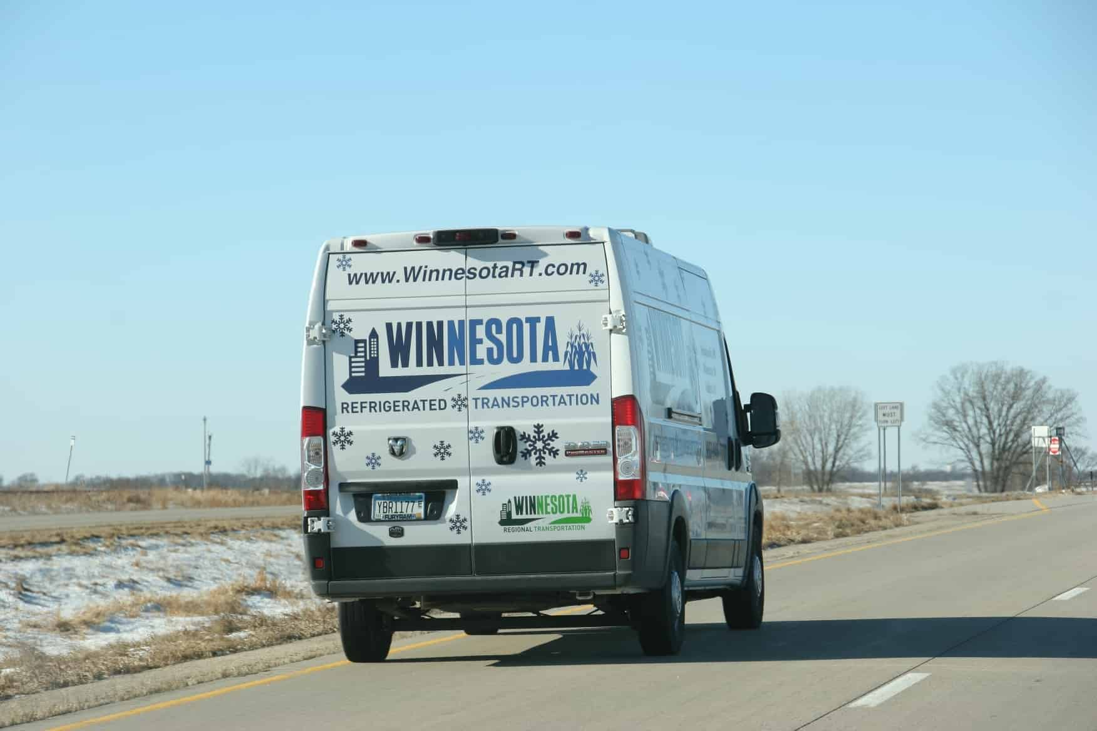
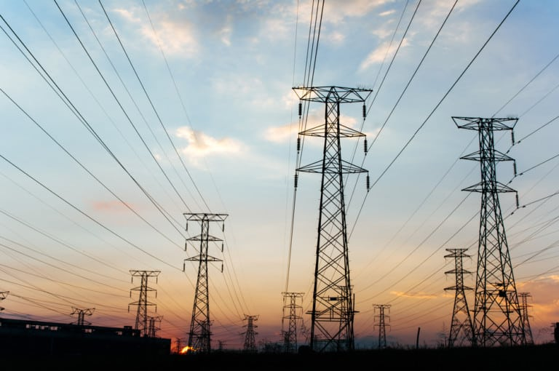

CaVE: A Cone-Aligned Approach for Fast Predict-then-Optimize
CPAIOR 2024 | University of Toronto
Examples
Vehicle Routing
Energy Scheduling
Portfolio Optimization

Slide 11
CaVE: A Cone-Aligned Approach for Fast Predict-then-Optimize
CPAIOR 2024 | University of Toronto
Examples
Vehicle Routing
Energy Scheduling
Portfolio Optimization
Unknown Costs: Travel Time, Electricity Prices, Asset Returns
Observed Features: Distance, Time, Weather, Financial Factors…

Slide 12
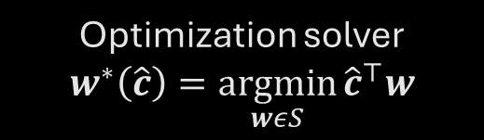
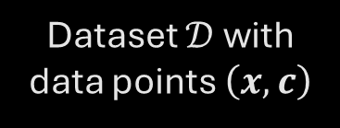

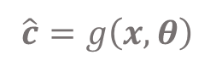
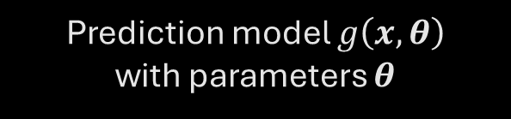



CaVE: A Cone-Aligned Approach for Fast Predict-then-Optimize
CPAIOR 2024 | University of Toronto
Decision-focused Learning
$$\hat{c}=g\left(x,θ\right)$$
$$\min_{w}{c^{⊤}w}$$
$$s.t. Aw≤b$$
….
$$w^{∗}\left(\hat{c}\right)$$
$$x$$
Dataset $𝒟$ with data points $\left(x,c\right)$
Prediction model $g\left(x,θ\right)$
with parameters $θ$
Optimization solver
$$w^{∗}\left(\hat{c}\right)=\underset{wεS}{argmin}{{\hat{c}}^{⊤}w}$$
Loss function $ℒ\left(∙\right)$
to measure decision error

Slide 13
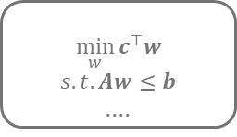
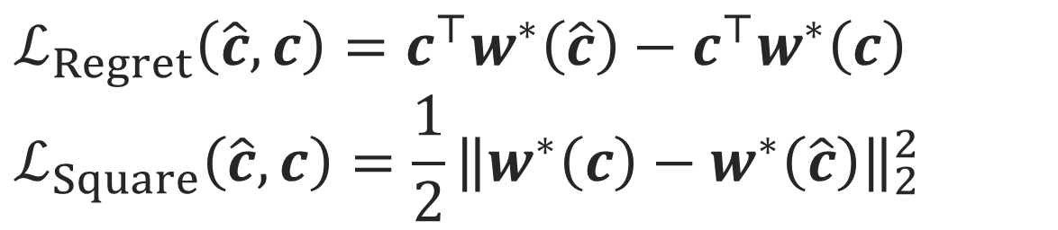





CaVE: A Cone-Aligned Approach for Fast Predict-then-Optimize
CPAIOR 2024 | University of Toronto
Decision-focused Learning
$$\hat{c}=g\left(x,θ\right)$$
$$\min_{w}{c^{⊤}w}$$
$$s.t. Aw≤b$$
….
$$w^{∗}\left(\hat{c}\right)$$
$$x$$
Dataset $𝒟$ with data points $\left(x,c\right)$
Prediction model $g\left(x,θ\right)$
with parameters $θ$
Optimization solver
$$w^{∗}\left(\hat{c}\right)=\underset{wεS}{argmin}{{\hat{c}}^{⊤}w}$$
Loss function $ℒ\left(∙\right)$
to measure decision error
e.g.
$$ℒ_{Regret}\left(\hat{c},c\right)=c^{⊤}w^{∗}\left(\hat{c}\right)−c^{⊤}w^{∗}\left(c\right)$$
$$ℒ_{Square}\left(\hat{c},c\right)={\frac{1}{2}\left\|w^{∗}\left(c\right)−w^{∗}\left(\hat{c}\right)\right\|}_{2}^{2}$$

Slide 14
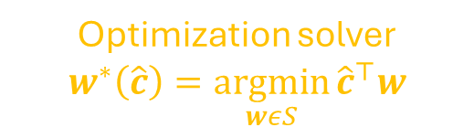
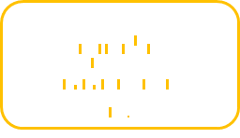
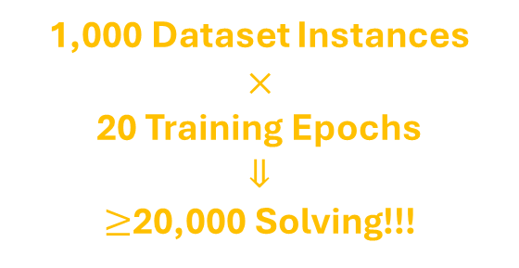
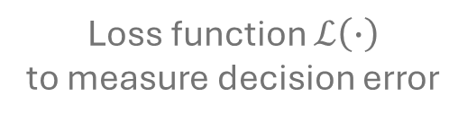
CaVE: A Cone-Aligned Approach for Fast Predict-then-Optimize
CPAIOR 2024 | University of Toronto
Decision-focused Learning
$$\hat{c}=g\left(x,θ\right)$$
$$\min_{w}{c^{⊤}w}$$
$$s.t. Aw≤b$$
….
$$w^{∗}\left(\hat{c}\right)$$
$$x$$
Dataset $𝒟$ with data points $\left(x,c\right)$
Prediction model $g\left(x,θ\right)$
with parameters $θ$
Optimization solver
$$w^{∗}\left(\hat{c}\right)=\underset{wεS}{argmin}{{\hat{c}}^{⊤}w}$$
Loss function $ℒ\left(∙\right)$
to measure decision error
1,000 Dataset Instances
$$×$$
20 Training Epochs
$$⇓$$
$≥$20,000 Solving!!!
Computational Bottleneck:
All state-of-the-art methods require repeated solving during the iteration.

Slide 15


CaVE: A Cone-Aligned Approach for Fast Predict-then-Optimize
CPAIOR 2024 | University of Toronto
Decision-focused Learning
$$\hat{c}=g\left(x,θ\right)$$
$$\min_{w}{c^{⊤}w}$$
$$s.t. Aw≤b$$
….
$$w^{∗}\left(\hat{c}\right)$$
$$x$$
Dataset $𝒟$ with data points $\left(x,c\right)$
Prediction model $g\left(x,θ\right)$
with parameters $θ$
Optimization solver
$$w^{∗}\left(\hat{c}\right)=\underset{wεS}{argmin}{{\hat{c}}^{⊤}w}$$
Loss function $ℒ\left(∙\right)$
to measure decision error
CaVE:
Replace the original optimization with projection (quadratic programming).

Slide 16



CaVE: A Cone-Aligned Approach for Fast Predict-then-Optimize
CPAIOR 2024 | University of Toronto
Geometric Intuition
$$c_{3}$$
$$c_{1}$$
$$c_{2}$$
Feasible Region
For LP, cost vectors in the same normal cone have the same optimal solutions.
$$w^{∗}\left(c_{1}\right)=w^{∗}\left(c_{2}\right)≠w^{∗}\left(c_{3}\right)$$

Slide 17

CaVE: A Cone-Aligned Approach for Fast Predict-then-Optimize
CPAIOR 2024 | University of Toronto
Geometric Intuition
True Optimal Solution
$$w^{∗}\left(c\right)$$
Feasible Region
For LP, optimal cone $𝓒^{∗}\left(c\right)$ is defined as the normal cone at the true optimal solution $w^{∗}\left(c\right)$.

Slide 18

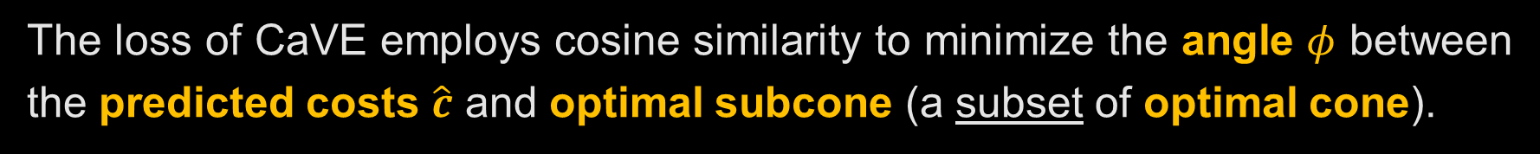



CaVE: A Cone-Aligned Approach for Fast Predict-then-Optimize
CPAIOR 2024 | University of Toronto
Similarity Loss Function
$$ℒ_{CaVE}\left(\hat{c},c\right)=−\cos{φ}$$
$$\hat{c}$$
$$φ$$
$$c$$
Optimal Cone
Feasible Region
The loss of CaVE employs cosine similarity to minimize the angle $φ$ between the predicted costs $\hat{c}$ and optimal subcone (a subset of optimal cone).

Slide 19
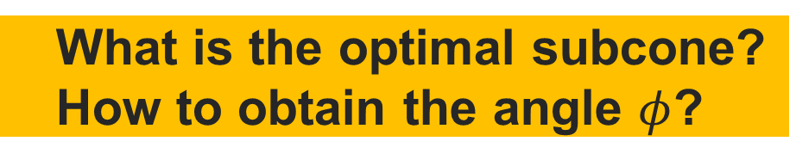
CaVE: A Cone-Aligned Approach for Fast Predict-then-Optimize
CPAIOR 2024 | University of Toronto
Similarity Loss Function
$$ℒ_{CaVE}\left(\hat{c},c\right)=−\cos{φ}$$
$$\hat{c}$$
$$φ$$
$$c$$
IMPORTANT QEUSTIONS:
Optimal Subcone
What is the optimal subcone?
How to obtain the angle $φ$?
Feasible Region
The loss of CaVE employs cosine similarity to minimize the angle $φ$ between the predicted costs $\hat{c}$ and optimal subcone (a subset of optimal cone).

Slide 20





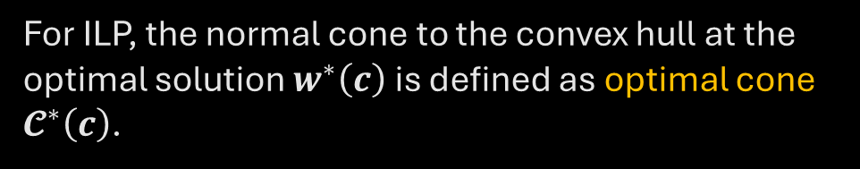


CaVE: A Cone-Aligned Approach for Fast Predict-then-Optimize
CPAIOR 2024 | University of Toronto
Optimal Subcone
$$w_{2}$$
Optimal Cone
$$𝓒^{∗}\left(c\right)$$
1.
For ILP, the normal cone to the convex hull at the optimal solution $w^{∗}\left(c\right)$ is defined as optimal cone $𝓒^{∗}\left(c\right)$.
$$1$$
$$w^{∗}\left(c\right)$$
Convex
Hull
$$0$$
$$1$$
$$w_{1}$$
Binary Linear Program

Slide 21
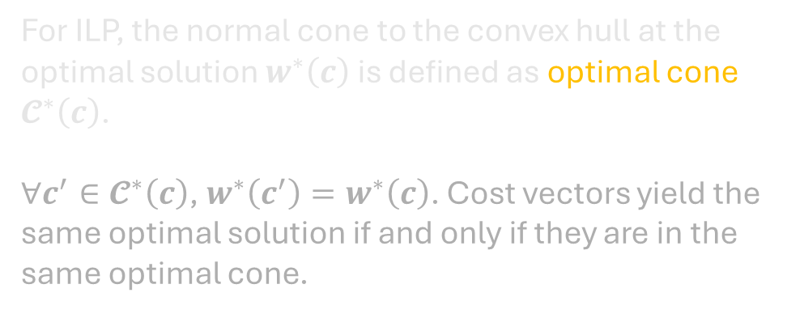
CaVE: A Cone-Aligned Approach for Fast Predict-then-Optimize
CPAIOR 2024 | University of Toronto
Optimal Subcone
$$w_{2}$$
Optimal Cone
$$𝓒^{∗}\left(c\right)$$
1.
For ILP, the normal cone to the convex hull at the optimal solution $w^{∗}\left(c\right)$ is defined as optimal cone $𝓒^{∗}\left(c\right)$.
$∀c^{′}∈𝓒^{∗}\left(c\right)$, $w^{∗}\left(c^{′}\right)=w^{∗}\left(c\right)$. Cost vectors yield the same optimal solution if and only if they are in the same optimal cone.
$$1$$
$$w^{∗}\left(c\right)$$
2.
Convex
Hull
$$0$$
$$1$$
$$w_{1}$$
Binary Linear Program

Slide 22
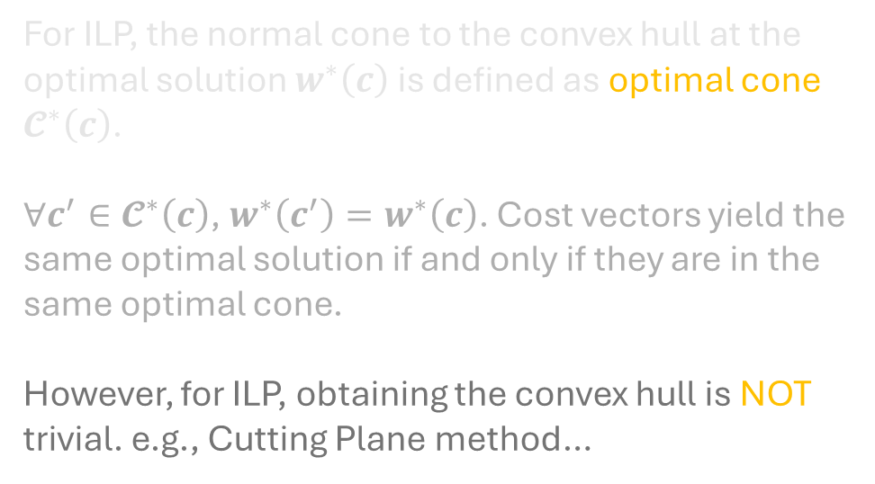
CaVE: A Cone-Aligned Approach for Fast Predict-then-Optimize
CPAIOR 2024 | University of Toronto
Optimal Subcone
$$w_{2}$$
Optimal Cone
$$𝓒^{∗}\left(c\right)$$
1.
For ILP, the normal cone to the convex hull at the optimal solution $w^{∗}\left(c\right)$ is defined as optimal cone $𝓒^{∗}\left(c\right)$.
$∀c^{′}∈𝓒^{∗}\left(c\right)$, $w^{∗}\left(c^{′}\right)=w^{∗}\left(c\right)$. Cost vectors yield the same optimal solution if and only if they are in the same optimal cone.
However, for ILP, obtaining the convex hull is NOT trivial. e.g., Cutting Plane method…
$$1$$
$$w^{∗}\left(c\right)$$
2.
Convex
Hull
$$0$$
$$1$$
$$w_{1}$$
3.
Binary Linear Program

Slide 23







CaVE: A Cone-Aligned Approach for Fast Predict-then-Optimize
CPAIOR 2024 | University of Toronto
Optimal Subcone
$$w_{2}$$
$$w_{2}$$
Optimal Cone
$$𝓒^{∗}\left(c\right)$$
Optimal Subcone
$${𝓢𝓒}^{∗}\left(c\right)$$
$$1$$
$$w^{∗}\left(c\right)$$
$$1$$
$$w^{∗}\left(c\right)$$
Feasible Region
Convex
Hull
$$0$$
$$1$$
$$w_{1}$$
$$0$$
$$1$$
$$w_{1}$$
Binary Linear Program
Linear Relaxation

Slide 24
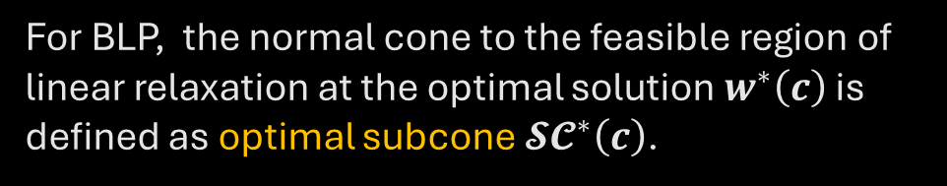
CaVE: A Cone-Aligned Approach for Fast Predict-then-Optimize
CPAIOR 2024 | University of Toronto
Optimal Subcone
$$w_{2}$$
Optimal Subcone
$${𝓢𝓒}^{∗}\left(c\right)$$
1.
For BLP, the normal cone to the feasible region of linear relaxation at the optimal solution $w^{∗}\left(c\right)$ is defined as optimal subcone ${𝓢𝓒}^{∗}\left(c\right)$.
$$1$$
$$w^{∗}\left(c\right)$$
Feasible Region
$$0$$
$$1$$
$$w_{1}$$
Linear Relaxation

Slide 25
CaVE: A Cone-Aligned Approach for Fast Predict-then-Optimize
CPAIOR 2024 | University of Toronto
Optimal Subcone
$$w_{2}$$
Optimal Subcone
$${𝓢𝓒}^{∗}\left(c\right)$$
1.
For BLP, the normal cone to the feasible region of linear relaxation at the optimal solution $w^{∗}\left(c\right)$ is defined as optimal subcone ${𝓢𝓒}^{∗}\left(c\right)$.
$$1$$
$$w^{∗}\left(c\right)$$
Note: This does not apply to general ILP！
Feasible Region
$$0$$
$$1$$
$$w_{1}$$
Linear Relaxation

Slide 26

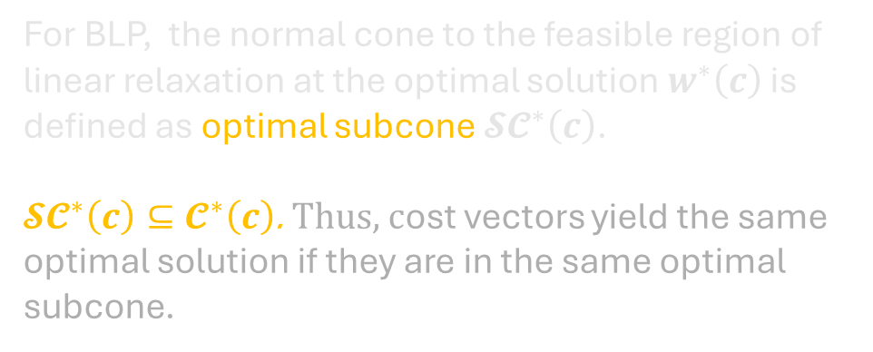

CaVE: A Cone-Aligned Approach for Fast Predict-then-Optimize
CPAIOR 2024 | University of Toronto
Optimal Subcone
$$w_{2}$$
Optimal Subcone
$${𝓢𝓒}^{∗}\left(c\right)$$
1.
For BLP, the normal cone to the feasible region of linear relaxation at the optimal solution $w^{∗}\left(c\right)$ is defined as optimal subcone ${𝓢𝓒}^{∗}\left(c\right)$.
${𝓢𝓒}^{∗}\left(c\right)⊆𝓒^{∗}\left(c\right)$. Thus, cost vectors yield the same optimal solution if they are in the same optimal subcone.
$$1$$
$$w^{∗}\left(c\right)$$
2.
Feasible Region
$$0$$
$$1$$
$$w_{1}$$
Optimal Cone
$$𝓒^{∗}\left(c\right)$$
Optimal Subcone
$${𝓢𝓒}^{∗}\left(c\right)$$
Linear Relaxation

Slide 27
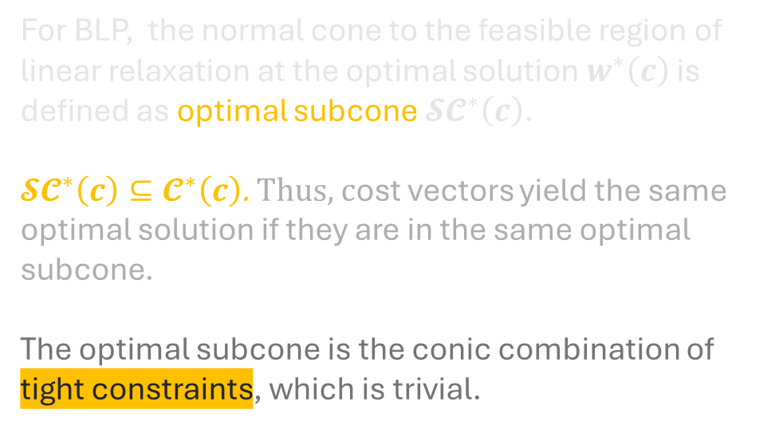
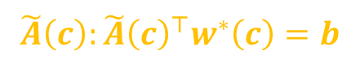
CaVE: A Cone-Aligned Approach for Fast Predict-then-Optimize
CPAIOR 2024 | University of Toronto
Optimal Subcone
$$w_{2}$$
Optimal Subcone
$${𝓢𝓒}^{∗}\left(c\right)$$
1.
For BLP, the normal cone to the feasible region of linear relaxation at the optimal solution $w^{∗}\left(c\right)$ is defined as optimal subcone ${𝓢𝓒}^{∗}\left(c\right)$.
${𝓢𝓒}^{∗}\left(c\right)⊆𝓒^{∗}\left(c\right)$. Thus, cost vectors yield the same optimal solution if they are in the same optimal subcone.
The optimal subcone is the conic combination of tight constraints, which is trivial.
$$1$$
$$w^{∗}\left(c\right)$$
2.
Feasible Region
3.
$$0$$
$$1$$
$$w_{1}$$
$$\tilde{A}\left(c\right):{\tilde{A}\left(c\right)}^{⊤}w^{∗}\left(c\right)=b$$
Linear Relaxation

Slide 28


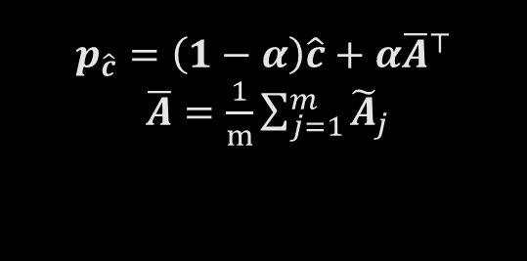





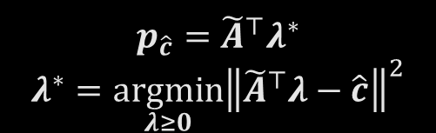
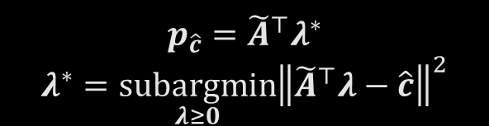






CaVE: A Cone-Aligned Approach for Fast Predict-then-Optimize
CPAIOR 2024 | University of Toronto
Projection
$$p_{\hat{c}}$$
$$p_{\hat{c}}$$
$$p_{\hat{c}}$$
$$\hat{c}$$
$$\hat{c}$$
$$\hat{c}$$
$$\overline{A}$$
$$φ$$
$$c$$
$$φ$$
$$c$$
$$φ$$
$$c$$
$$p_{\hat{c}}={\tilde{A}}^{⊤}λ^{∗}$$
$$λ^{∗}=\underset{λ≥0}{argmin}{{\left\|{\tilde{A}}^{⊤}λ−\hat{c}\right\|}^{2}}$$
$$p_{\hat{c}}={\tilde{A}}^{⊤}λ^{∗}$$
$$λ^{∗}=\underset{λ≥0}{subargmin}{{\left\|{\tilde{A}}^{⊤}λ−\hat{c}\right\|}^{2}}$$
$$p_{\hat{c}}=\left(1−α\right)\hat{c}+α{\overline{A}}^{⊤}$$
$\overline{A}=\frac{1}{m}\sum_{j=1}^{m}{{\tilde{A}}_{j}}$
Exact Projection
Inner Projection
Heuristic Projection
CaVE Exact performs exact projection, wherein the optimal solution of the NNLS is on the surface of the cone.
This approach results in the vanishing gradients as the predicted cost vector close the surface.

Slide 29
CaVE: A Cone-Aligned Approach for Fast Predict-then-Optimize
CPAIOR 2024 | University of Toronto
Projection
$$p_{\hat{c}}$$
$$p_{\hat{c}}$$
$$p_{\hat{c}}$$
$$\hat{c}$$
$$\hat{c}$$
$$\hat{c}$$
$$\overline{A}$$
$$φ$$
$$c$$
$$φ$$
$$c$$
$$φ$$
$$c$$
$$p_{\hat{c}}={\tilde{A}}^{⊤}λ^{∗}$$
$$λ^{∗}=\underset{λ≥0}{argmin}{{\left\|{\tilde{A}}^{⊤}λ−\hat{c}\right\|}^{2}}$$
$$p_{\hat{c}}={\tilde{A}}^{⊤}λ^{∗}$$
$$λ^{∗}=\underset{λ≥0}{subargmin}{{\left\|{\tilde{A}}^{⊤}λ−\hat{c}\right\|}^{2}}$$
$$p_{\hat{c}}=\left(1−α\right)\hat{c}+α{\overline{A}}^{⊤}$$
$\overline{A}=\frac{1}{m}\sum_{j=1}^{m}{{\tilde{A}}_{j}}$
Exact Projection
Inner Projection
Heuristic Projection
The goal is to obtain a projection of the predicted cost vector that lies inside the subcone. (suboptimal solution)
Since the solver (Clarabel) uses the primal-dual interior point, the feasibility is guaranteed at each iteration. We can simply set the maximum iterations.

Slide 30
CaVE: A Cone-Aligned Approach for Fast Predict-then-Optimize
CPAIOR 2024 | University of Toronto
Projection
$$p_{\hat{c}}$$
$$p_{\hat{c}}$$
$$p_{\hat{c}}$$
$$\hat{c}$$
$$\hat{c}$$
$$\hat{c}$$
$$\overline{A}$$
$$φ$$
$$c$$
$$φ$$
$$c$$
$$φ$$
$$c$$
$$p_{\hat{c}}={\tilde{A}}^{⊤}λ^{∗}$$
$$λ^{∗}=\underset{λ≥0}{argmin}{{\left\|{\tilde{A}}^{⊤}λ−\hat{c}\right\|}^{2}}$$
$$p_{\hat{c}}={\tilde{A}}^{⊤}λ^{∗}$$
$$λ^{∗}=\underset{λ≥0}{subargmin}{{\left\|{\tilde{A}}^{⊤}λ−\hat{c}\right\|}^{2}}$$
$$p_{\hat{c}}=\left(1−α\right)\hat{c}+α{\overline{A}}^{⊤}$$
$\overline{A}=\frac{1}{m}\sum_{j=1}^{m}{{\tilde{A}}_{j}}$
Exact Projection
Inner Projection
Heuristic Projection
A heuristic projection that does not require solving NNLS and relies on simple operations.
This approach does NOT guarantee feasibility, yet it ensures that the cost vector is pushed towards the cone.

Slide 31
CaVE: A Cone-Aligned Approach for Fast Predict-then-Optimize
CPAIOR 2024 | University of Toronto
Projection
$$p_{\hat{c}}$$
$$p_{\hat{c}}$$
$$p_{\hat{c}}$$
$$\hat{c}$$
$$\hat{c}$$
$$\hat{c}$$
$$\overline{A}$$
$$φ$$
$$c$$
$$φ$$
$$c$$
$$φ$$
$$c$$
$$p_{\hat{c}}={\tilde{A}}^{⊤}λ^{∗}$$
$$λ^{∗}=\underset{λ≥0}{argmin}{{\left\|{\tilde{A}}^{⊤}λ−\hat{c}\right\|}^{2}}$$
$$p_{\hat{c}}={\tilde{A}}^{⊤}λ^{∗}$$
$$λ^{∗}=\underset{λ≥0}{subargmin}{{\left\|{\tilde{A}}^{⊤}λ−\hat{c}\right\|}^{2}}$$
$$p_{\hat{c}}=\left(1−α\right)\hat{c}+α{\overline{A}}^{⊤}$$
$\overline{A}=\frac{1}{m}\sum_{j=1}^{m}{{\tilde{A}}_{j}}$
Exact Projection
Inner Projection
Heuristic Projection
CaVE Exact
CaVE+
CaVE Hybrid

Slide 32
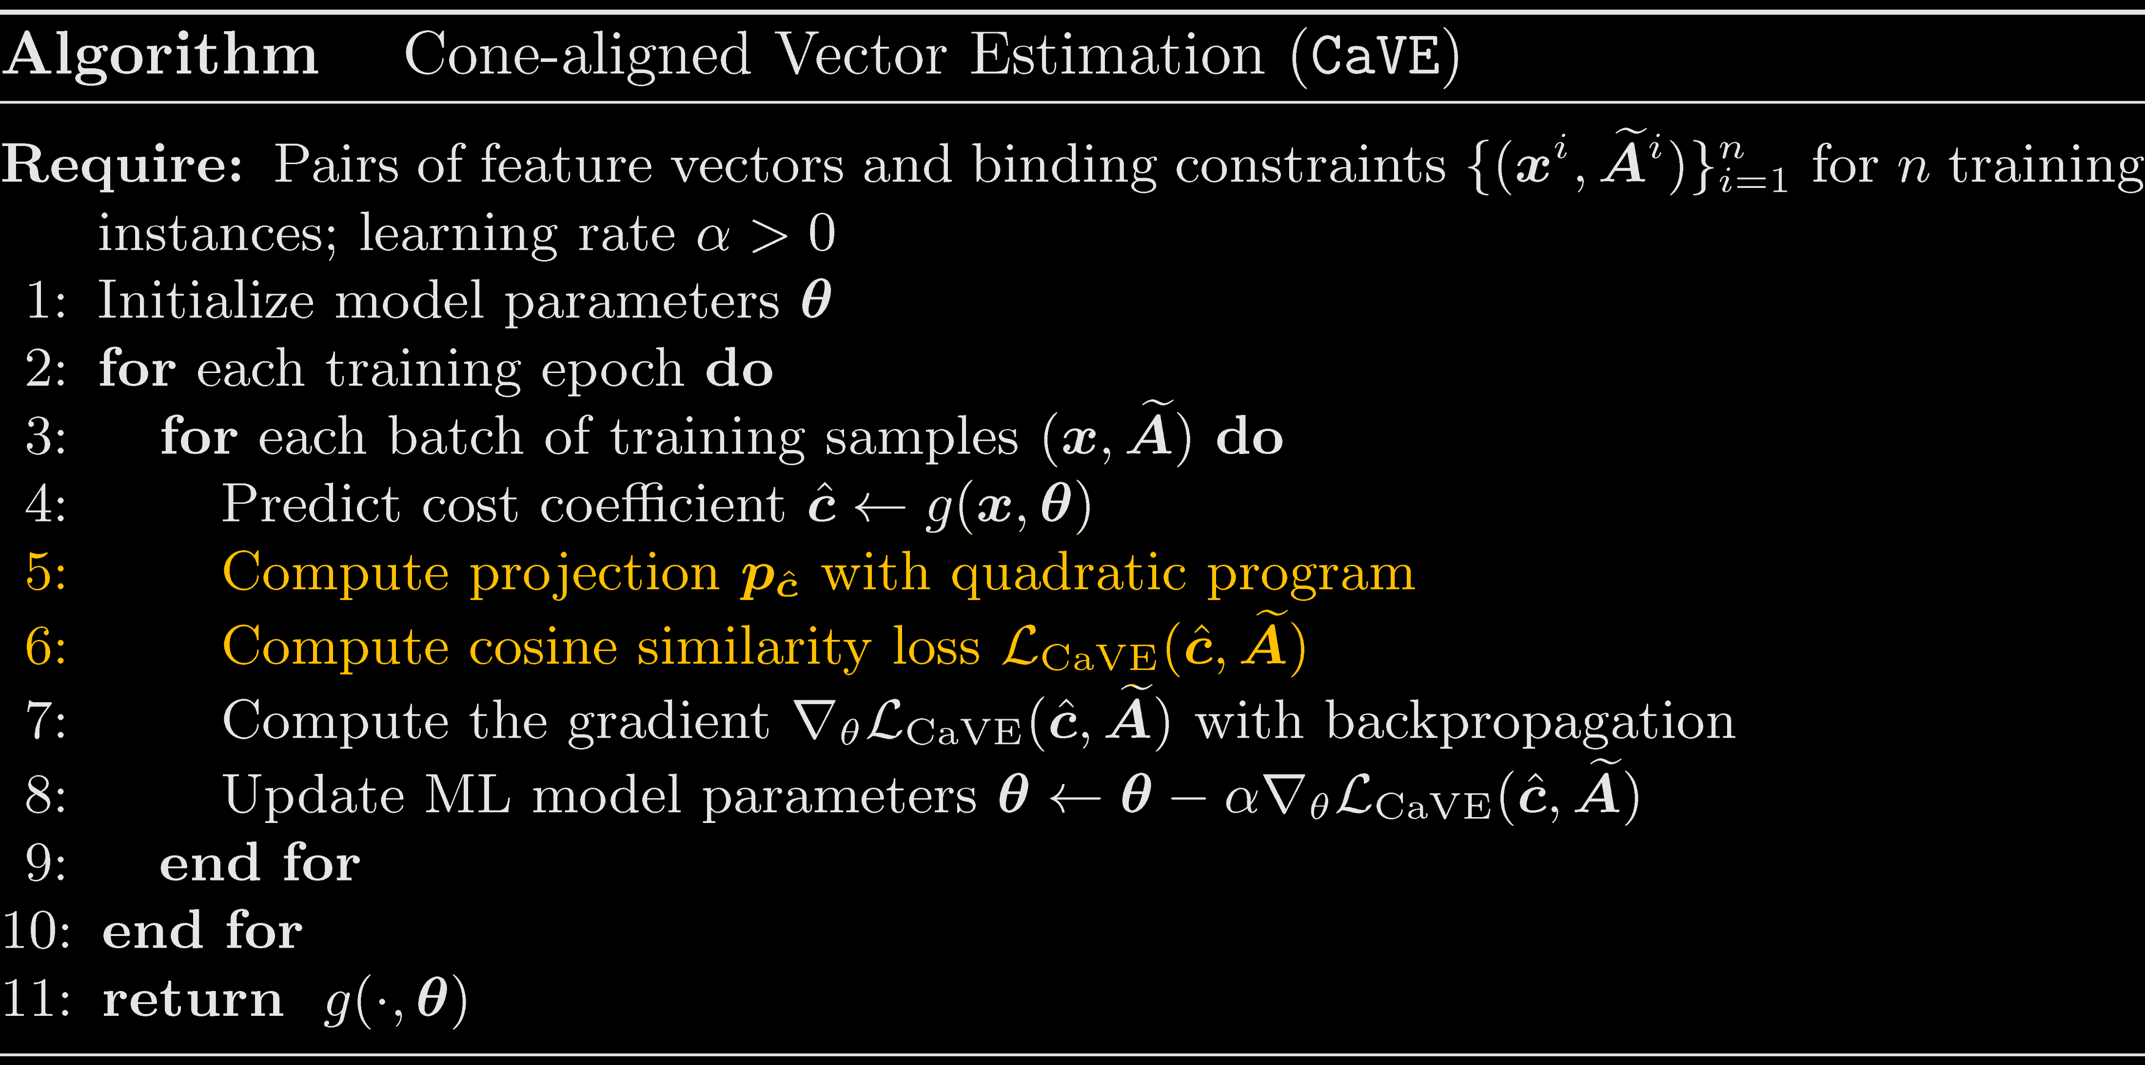
CaVE: A Cone-Aligned Approach for Fast Predict-then-Optimize
CPAIOR 2024 | University of Toronto
Algorithm

Slide 33

CaVE: A Cone-Aligned Approach for Fast Predict-then-Optimize
CPAIOR 2024 | University of Toronto
Experiments - SP5
Shortest Path on $5×5$ Grid
Average Test Normalized Regret (%) with Standard Deviation
Methods | 2-Stage | CaVE-E | CaVE+ | CaVE-H | SPO+ | PFYL | NCE
Deg 4 | 8.82 ± 1.15 | 10.73 ± 1.54 | 8.39 ± 0.95 | 8.35 ± 0.88 | 7.79 ± 1.00 | 7.68 ± 0.99 | 11.34 ± 1.11
Deg 6 | 12.58 ± 2.14 | 11.30 ± 1.30 | 8.89 ± 0.90 | 8.84 ± 1.00 | 7.72 ± 1.11 | 7.86 ± 0.96 | 13.78 ± 1.58
Average Training Time (Sec) with Standard Deviation
Methods | 2-Stage | CaVE-E | CaVE+ | CaVE-H | SPO+ | PFYL | NCE
Deg 4 | 1.52 ± 0.14 | 4.64 ± 0.09 | 4.89 ± 0.12 | 2.57 ± 0.19 | 17.64 ± 0.12 | 18.52 ± 0.31 | 4.50 ± 0.48
Deg 6 | 1.38 ± 0.13 | 3.52 ± 0.11 | 3.72 ± 0.14 | 2.39 ± 0.19 | 18.68 ± 0.40 | 17.78 ± 0.13 | 4.38 ± 0.42

Slide 34
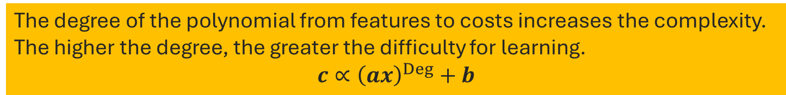
CaVE: A Cone-Aligned Approach for Fast Predict-then-Optimize
CPAIOR 2024 | University of Toronto
Experiments - SP5
Shortest Path on $5×5$ Grid
Average Test Normalized Regret (%) with Standard Deviation
Methods | 2-Stage | CaVE-E | CaVE+ | CaVE-H | SPO+ | PFYL | NCE
Deg 4 | 8.82 ± 1.15 | 10.73 ± 1.54 | 8.39 ± 0.95 | 8.35 ± 0.88 | 7.79 ± 1.00 | 7.68 ± 0.99 | 11.34 ± 1.11
Deg 6 | 12.58 ± 2.14 | 11.30 ± 1.30 | 8.89 ± 0.90 | 8.84 ± 1.00 | 7.72 ± 1.11 | 7.86 ± 0.96 | 13.78 ± 1.58
Synthetic Ground Truth Generation:
The degree of the polynomial from features to costs increases the complexity.
The higher the degree, the greater the difficulty for learning.
$$c∝{\left(ax\right)}^{Deg}+b$$
Average Training Time (Sec) with Standard Deviation
Methods | 2-Stage | CaVE-E | CaVE+ | CaVE-H | SPO+ | PFYL | NCE
Deg 4 | 1.52 ± 0.14 | 4.64 ± 0.09 | 4.89 ± 0.12 | 2.57 ± 0.19 | 17.64 ± 0.12 | 18.52 ± 0.31 | 4.50 ± 0.48
Deg 6 | 1.38 ± 0.13 | 3.52 ± 0.11 | 3.72 ± 0.14 | 2.39 ± 0.19 | 18.68 ± 0.40 | 17.78 ± 0.13 | 4.38 ± 0.42

Slide 35

CaVE: A Cone-Aligned Approach for Fast Predict-then-Optimize
CPAIOR 2024 | University of Toronto
Experiments - TSP20
Traveling Salesperson with $20$ Nodes
Average Test Normalized Regret (%) with Standard Deviation
Methods | 2-Stage | CaVE-E | CaVE+ | CaVE-H | SPO+ | PFYL | NCE
Deg 4 | 12.12 ± 0.89 | 7.35 ± 0.40 | 6.20 ± 0.24 | 7.69 ± 0.33 | 5.95 ± 0.16 | 6.56 ± 0.21 | 12.21 ± 0.88
Deg 6 | 21.32 ± 1.81 | 8.01 ± 0.45 | 6.97 ± 0.37 | 9.52 ± 0.64 | 7.48 ± 0.36 | 7.41 ± 0.37 | 14.31 ± 0.40
Average Training Time (Sec) with Standard Deviation
Methods | 2-Stage | CaVE-E | CaVE+ | CaVE-H | SPO+ | PFYL | NCE
Deg 4 | 1.52 ± 0.10 | 113.56 ± 3.16 | 107.15 ± 3.80 | 27.06 ± 2.17 | 175.23 ± 4.95 | 220.21 ± 24.20 | 25.92 ± 4.23
Deg 6 | 1.53 ± 0.19 | 158.66 ± 9.65 | 102.19 ± 10.38 | 30.17 ± 2.62 | 185.13 ± 7.44 | 185.02 ± 5.09 | 25.48 ± 3.66

Slide 36

CaVE: A Cone-Aligned Approach for Fast Predict-then-Optimize
CPAIOR 2024 | University of Toronto
Experiments - TSP50
Traveling Salesperson with $50$ Nodes
Average Test Normalized Regret (%) with Standard Deviation
Methods | 2-Stage | CaVE-E | CaVE+ | CaVE-H | SPO+ | PFYL | NCE
Deg 4 | 28.16 ± 1.08 | 15.19 ± 0.65 | 7.69 ± 0.22 | 9.59 ± 0.44 | 7.57 ± 0.20 | 8.03 ± 0.23 | 14.31 ± 0.40
Deg 6 | 52.61 ± 2.36 | 23.25 ± 2.41 | 8.57 ± 0.38 | 11.28 ± 0.80 | 10.26 ± 0.46 | 9.00 ± 0.52 | 17.12 ± 0.48
Average Training Time (Sec) with Standard Deviation
Methods | 2-Stage | CaVE-E | CaVE+ | CaVE-H | SPO+ | PFYL | NCE
Deg 4 | 1.55 ± 0.18 | 611.47 ± 23.52 | 518.07 ± 51.89 | 196.96 ± 35.92 | 1220.68 ± 85.39 | 1328.99 ± 28.87 | 151.80 ± 24.21
Deg 6 | 1.16 ± 0.13 | 502.71 ± 16.03 | 573.87 ± 20.19 | 253.93 ± 27.67 | 1191.29 ± 42.63 | 1456.21 ± 34.18 | 155.95 ± 24.46

Slide 37

CaVE: A Cone-Aligned Approach for Fast Predict-then-Optimize
CPAIOR 2024 | University of Toronto
Experiments - CVRP20
Capacity Vehicle Routing with $20$ Nodes
Average Test Normalized Regret (%) with Standard Deviation
Methods | 2-Stage | CaVE-E | CaVE+ | CaVE-H | SPO+ | PFYL | NCE
Deg 4 | 10.10 ± 0.64 | 9.26 ± 1.56 | 6.44 ± 0.24 | 7.92 ± 0.52 | 5.94 ± 0.25 | 6.32 ± 0.28 | 15.77 ± 0.96
Deg 6 | 19.50 ± 1.22 | 11.64 ± 0.25 | 7.94 ± 0.54 | 11.44 ± 1.14 | 8.75 ± 0.28 | 8.09 ± 0.57 | 18.96 ± 1.01
Average Training Time (Sec) with Standard Deviation
Methods | 2-Stage | CaVE-E | CaVE+ | CaVE-H | SPO+ | PFYL | NCE
Deg 4 | 1.65 ± 0.48 | 213.56 ± 42.36 | 153.56 ± 11.08 | 44.52 ± 6.27 | 7020.11 ± 1043.05 | 3773.31 ± 288.84 | 583.56 ± 170.67
Deg 6 | 1.54 ± 0.25 | 208.95 ± 12.90 | 127.94 ± 13.84 | 51.83 ± 8.78 | 2204.83 ± 99.86 | 6197.84 ± 288.63 | 470.20 ± 84.46

Slide 38

CaVE: A Cone-Aligned Approach for Fast Predict-then-Optimize
CPAIOR 2024 | University of Toronto
Experiments - CVRP30
Capacity Vehicle Routing with $30$ Nodes
Test Normalized Regret (%)
Methods | 2-Stage | CaVE-E | CaVE+ | CaVE-H | SPO+ | PFYL | NCE
Deg 4 | 19.72 | 12.54 | 9.13 | 9.99 | N/A |  | 18.28
Due to the scale of the problem, we did not repeat our experimental evaluation with random seeds.
Training Time (Sec)
Methods | 2-Stage | CaVE-E | CaVE+ | CaVE-H | SPO+ | PFYL | NCE
Deg 4 | 9.27 | 331.73 | 287.77 | 132.62 | ≥100h |  | 884.95

Slide 39


CaVE: A Cone-Aligned Approach for Fast Predict-then-Optimize
CPAIOR 2024 | University of Toronto
Experiments - Relaxation
Traveling Salesperson with $50$ Nodes
Average Test Normalized Regret (%)
Average Training Time (Sec)
Methods | CaVE+ | SPO+ Rel | PFYL Rel
Deg 4 | 7.69 ± 0.22 | 10.17 ± 0.23 | 11.11 ± 0.33
Deg 6 | 8.57 ± 0.38 | 13.14 ± 0.46 | 13.38 ± 0.58
Methods | CaVE+ | SPO+ Rel | PFYL Rel
Deg 4 | 518.07 ± 51.89 | 386.06 ± 9.69 | 536.67 ± 4.94
Deg 6 | 573.87 ± 20.19 | 636.99 ± 3.04 | 510.37 ± 3.46
Capacity Vehicle Routing with $20$ Nodes
Average Test Normalized Regret (%)
Average Training Time (Sec)
Methods | CaVE+ | SPO+ Rel | PFYL Rel
Deg 4 | 6.44 ± 0.24 | 8.03 ± 0.38 | 17.07 ± 0.63
Deg 6 | 7.94 ± 0.54 | 15.73 ± 0.39 | 19.19 ± 1.66
Methods | CaVE+ | SPO+ Rel | PFYL Rel
Deg 4 | 153.56 ± 11.08 | 78.95 ± 0.73 | 78.80 ± 1.19
Deg 6 | 127.94 ± 13.84 | 78.74 ± 3.82 | 81.80 ± 0.86

Slide 40



Thank You

